Slide 1

Dairy Farm Management
THE INQUISITIVES

Slide 2
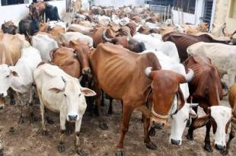
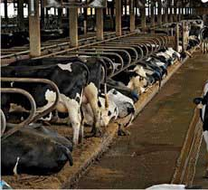
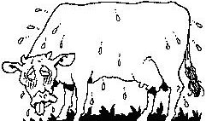

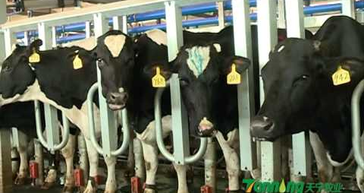
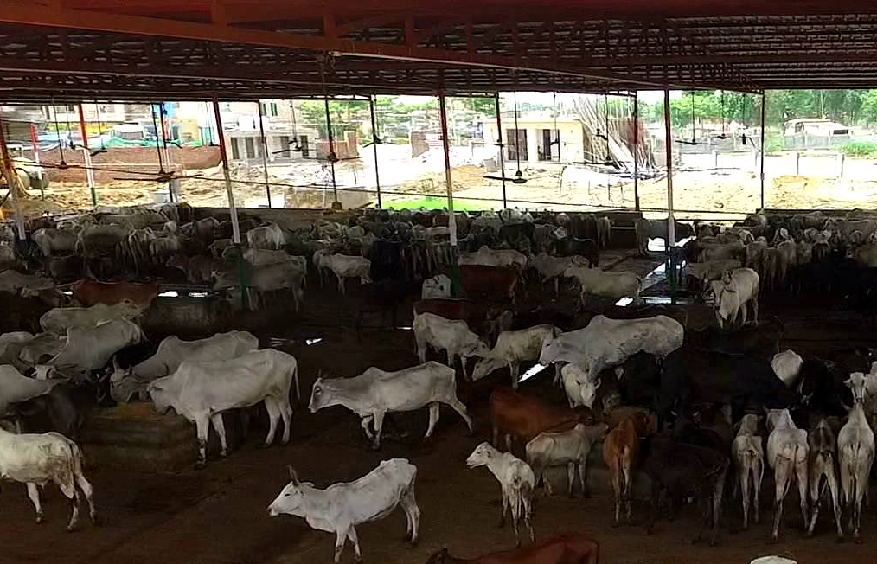
Executive Summary

Slide 3
Broker/ Trader
Farmer
Input dealer
Transporter
Target customers
Processing Unit
Consultant/ Veterinary assistance

Slide 4


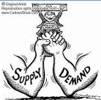


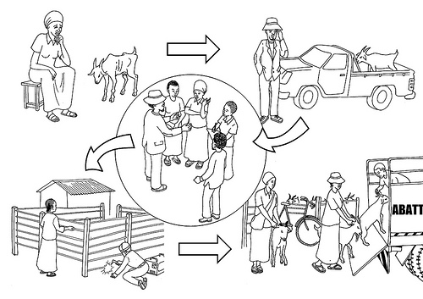
Problems/Opportunity
Price Discovery?
Notes:
Information asymmetry
Inadequate demand and supply chain matching
Inefficient price discovery mechanism and logistic channels
Unawareness about different government schemes
Lack of financial management
Lack of a common trading platform for dairy products

Slide 5

Value Proposition (USP)
Common Platform
Price Discovery
Economics calculator
Trading
Platform
Government
Schemes
Competitors:
Cattle Farm Management
PashuPoshan
Grass to Milk
Dairy Info
Updates
USP
Notes:
Common platform for connecting different communities to their target customers
Transparent price discovery mechanism
Trading platform
Provide economics calculator
New updates about advancements in dairy Industry
Telling about government schemes:
These trading platforms combine technological efficiency and market friendly trading features in a transparent atmosphere to make trading a rich and rewarding experience.
Initial investment is minimal
Aggressive marketing strategy

Slide 6
Business/Revenue model
Business/
Revenue model
E-trading
In-app purchases
In-app advertising
Subscription

Slide 7
Bidding Platform
Buyers
No. of buyers | 2
Quantity | 70-100 litre
Price (INR) /litre | 50
Sellers
No. of sellers | 50
Quantity | 20-50 litre
Price (INR) /litre

Slide 8
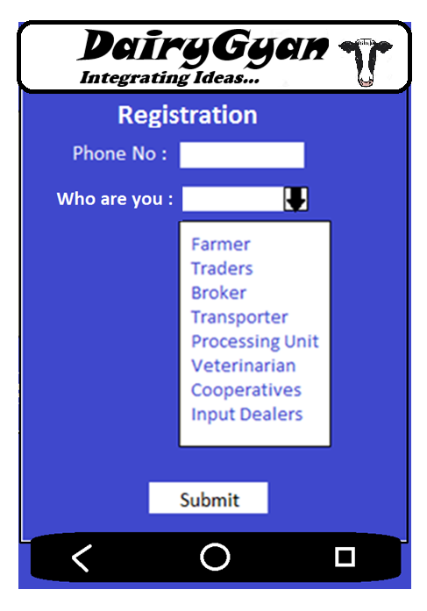
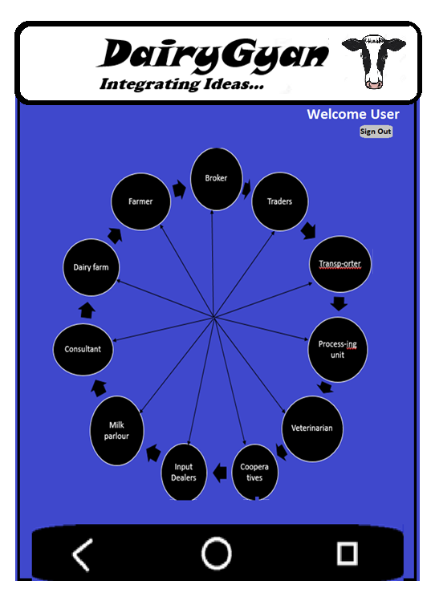
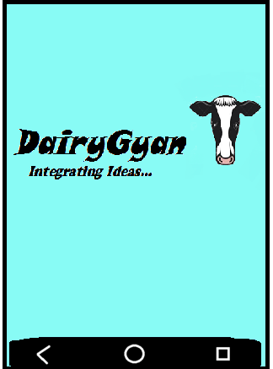
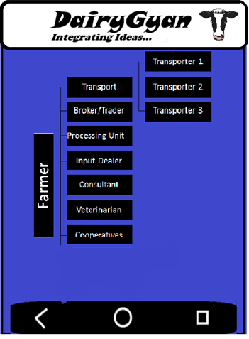
Glimpse of Dairygyan

Slide 9
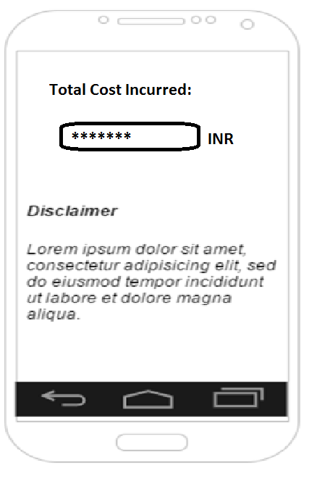

Slide 10
Marketing Plan and scaling
Panchayat
Identifying Active Farmers
Dividing Target Customers
Hiring local unemployedperson
Mobile Recharge Shops
Registration
Pamphlet
Notes:
Panchayat
Identifying the active farmers of that village
Dividing target customers into 2 sections
Pamphlet
Demonstration and Helping them to get registered
Panchayat computers
Mobile recharge shops
Hiring a local unemployed person

